Slide 1
GAME Analysis with SQL
Project by: Md.Mehedi Hasan
Data Analyst Intern
Mentorness

Slide 2
Content:
1. Project objective
2. Datasets
-player details
-level details
3. Analysis (Queries)
4. Conclusion

Slide 3
Objective
"Decode Gaming Behavior" analyzes a gaming application's dataset
"Player Details" and "Level Details" tables. Its purpose is to extract insights
Player behavior and performance. Using SQL queries, we want to understand
Areas of player engagement, skill enhancement and game experience enhancement.

Slide 4
Dataset Description
Player Details Table
`P_ID`: Player ID
`PName`: Player Name
`L1_status`: Level 1 Status
`L2_status`: Level 2 Status
`L1_code`: System generated Level 1 Code
`L2_code`: System generated Level 2 Code
Level Details Table
`P_ID`: Player ID
`Dev_ID`: Device ID
`start_time`: Start Time
`stages_crossed`: Stages Crossed
`level`: Game Level
`difficulty`: Difficulty Level
`kill_count`: Kill Count
`headshots_count`: Headshots Count
`score`: Player Score
`lives_earned`: Extra Lives Earned

Slide 5
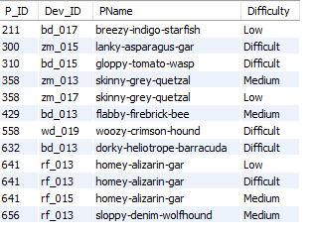
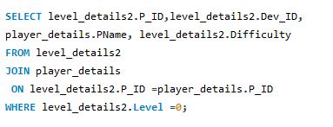
Qes_1. Extract `P_ID`, `Dev_ID`, `PName`, and `Difficulty_level` of all players at Level 0.

Slide 6
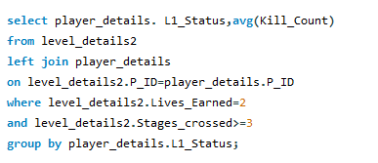
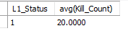
Qes_2. Find `Level1_code`wise average `Kill_Count` where `lives_earned` is 2, and at least 3 stages are crossed.

Slide 7
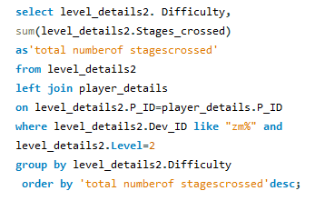
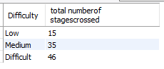
Qes_3. Find the total number of stages crossed at each difficulty level for Level 2 with players using `zm_series` devices. Arrange the result in decreasing order of the total number of stages crossed.

Slide 8
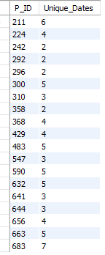
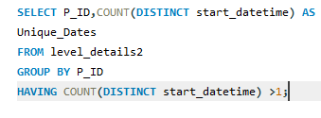
Qes_4. Extract `P_ID` and the total number of unique dates for those players who have played games on multiple days.

Slide 9
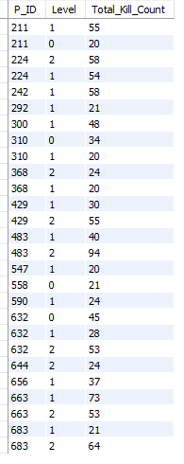
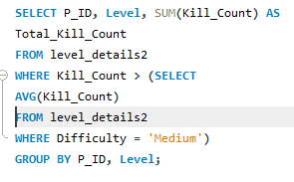
Qes_5. Find `P_ID` and levelwise sum of `kill_counts` where `kill_count` is greater than the average kill count for Medium difficulty.

Slide 10
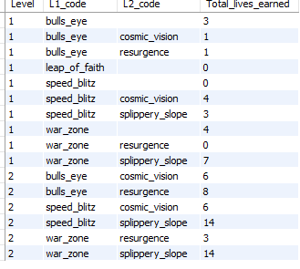
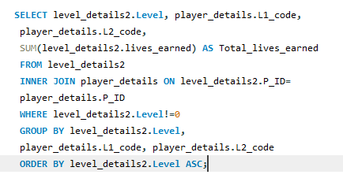
Qes_6. Find `Level` and its corresponding `Level_code`wise sum of lives earned, excluding Level 0. Arrange in ascending order of level.

Slide 11
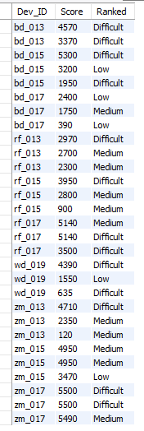
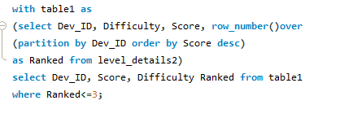
Qes_7. Find the top 3 scores based on each `Dev_ID` and rank them in increasing order using `Row_Number`. Display the difficulty as well.

Slide 12
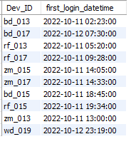
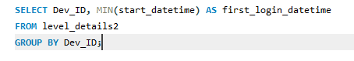
Qes_8. Find the `first_login` datetime for each device ID.

Slide 13
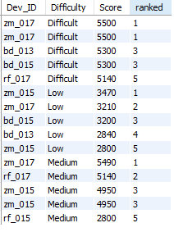
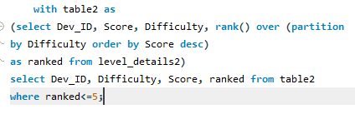
Qes_9. Find the top 5 scores based on each difficulty level and rank them in increasing order using `Rank`. Display `Dev_ID` as well

Slide 14
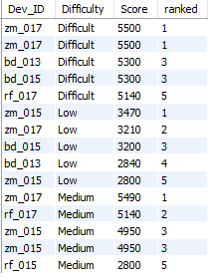
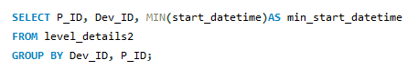
Qes_10. Find the device ID that is first logged in (based on `start_datetime`) for each player (`P_ID`). Output should contain player ID, device ID, and first login datetime.

Slide 15
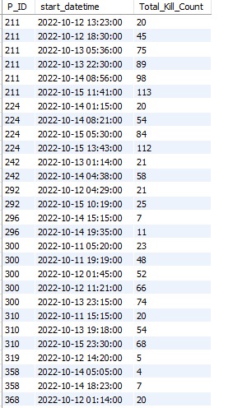
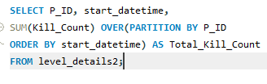
Qes_11. For each player and date, determine how many `kill_counts` were played by the player so far. a) Using window functions

Slide 16
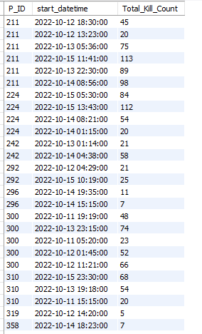
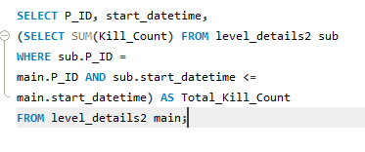
Qes_11. For each player and date, determine how many `kill_counts` were played by the player so far. b) Without window functions

Slide 17
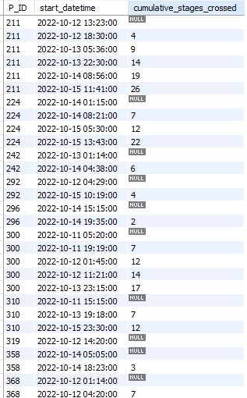
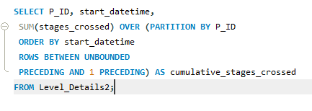
Qes_12. Find the cumulative sum of stages crossed over `start_datetime` for each `P_ID`, excluding the most recent `start_datetime`.

Slide 18
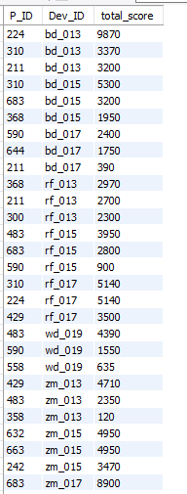
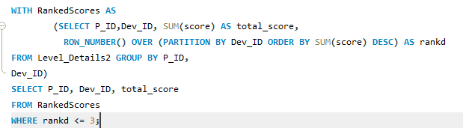
Qes_13. Extract the top 3 highest sums of scores for each `Dev_ID` and the corresponding `P_ID`.

Slide 19
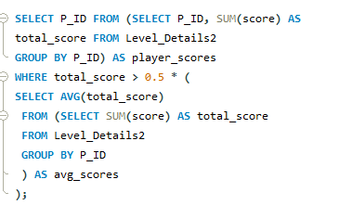
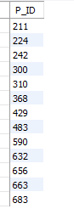
Qes_14. Find players who scored more than 50% of the average score, scored by the sum of scores for each `P_ID`.

Slide 20
Thank You
Mentorness

